Slide 1
Slide 18
Event Based Widget
Dasar-Dasar Pemrograman 1
Semester Ganjil 2016/2017

Slide 2
The Control Variable
A Tkinter control variable is a special object that acts like a regular Python variable that collects value in the widget
Tkinter uses control variables for a number of important functions, for example:
  Hold the current state in the Checkbuttons widget
  Control variables hold text string value for several widget, such as Entry widget.
There are three classes of control variable:
  IntVar()
  DoubleVar()
  StringVar()
Control variable has two methods:
  get() : returns the current value of the variable
  set(value) : Changes the current value of the variable
Dasar-Dasar Pemrograman Ganjil 2016-2017

Slide 3
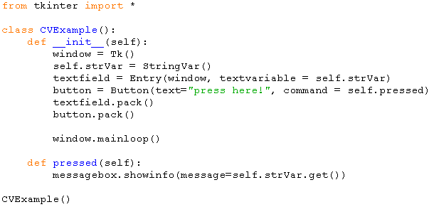
Example
Dasar-Dasar Pemrograman Ganjil 2016-2017

Slide 4
Radiobutton
This widget implements a multiple-choice button, which is a way to offer many possible selections to the user and lets user choose only one of them
Syntax:
  variable = Radiobutton(master, options..)
Important attributes:
  variable : the control variable of the widget
  value : the value to be set to control variable when the object is turned on
  text : text to be shown as a label of radiobutton
  command : event handler of radiobutton
  deselect() : method to clear (turns off) the radiobutton
  select() : method to set (turns on) the radiobutton
Dasar-Dasar Pemrograman Ganjil 2016-2017

Slide 5
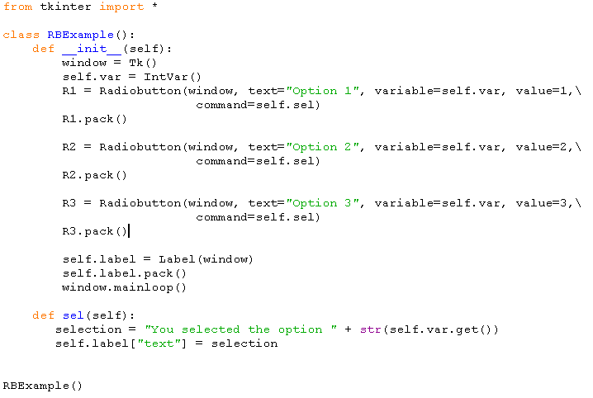
Example
Dasar-Dasar Pemrograman Ganjil 2016-2017

Slide 6
Checkbutton
The Checkbutton widget is used to display options to a user as toggle buttons.
By default, a checkbutton's associated control variable will be set to 1 when it is set (on) and 0 when it is cleared (off)
Syntax:
  Variable = Checkbutton(master, options,…)
Important attributes:
  variable : the control variable of the widget
  onvalue : set a value when the checkbutton is on (default 1)
  offvalue : set a value when the checkbutton is off (default 0)
  text : text to be shown as a label of checkbutton
  command : event handler of checkbutton
  deselect() : method to clear (turns off) the radiobutton
  select() : method to set (turns on) the radiobutton
  toggle() : method to clear if set, set if cleared
Dasar-Dasar Pemrograman Ganjil 2016-2017

Slide 7
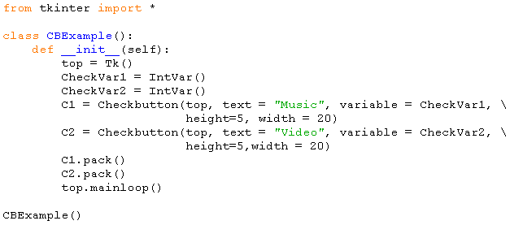
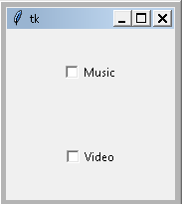
Example
Dasar-Dasar Pemrograman Ganjil 2016-2017

Slide 8
Canvas
We can use the Canvas widget for displaying shapes
We can use the methods:
  create_rectangle: to draw rectangle on a canvas
  create_oval: to draw oval on a canvas
  create_arc: to draw arc on a canvas
  create_polygon: to draw polygon on a canvas
  create_line: to draw line on a canvas
Dasar-Dasar Pemrograman Ganjil 2016-2017

Slide 9
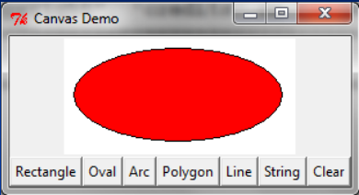
Example
The example program displays a rectangle, an oval, an arc, a polygon, a line, and a text string
The objects are all controlled by buttons
Dasar-Dasar Pemrograman Ganjil 2016-2017

Slide 10
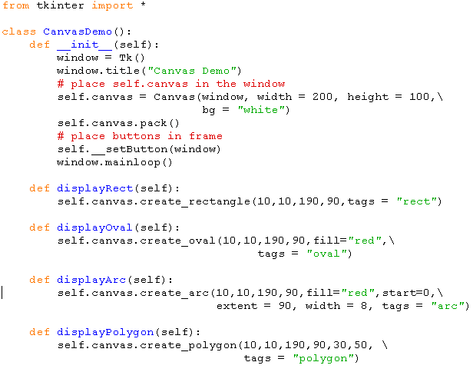
Example
Dasar-Dasar Pemrograman Ganjil 2016-2017

Slide 11
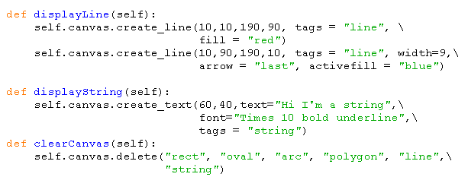
Example (cont.)
Dasar-Dasar Pemrograman Ganjil 2016-2017

Slide 12
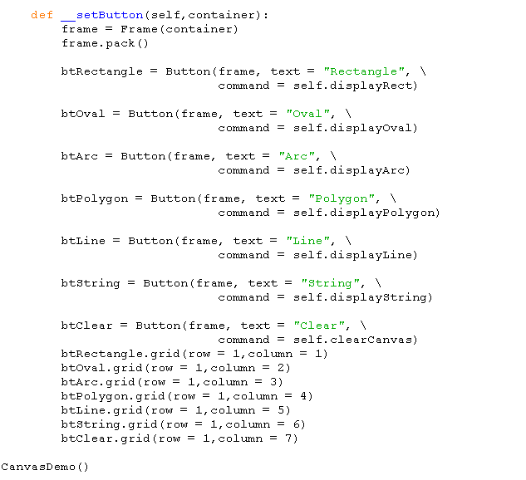
Example (cont.)
Dasar-Dasar Pemrograman Ganjil 2016-2017

Slide 13
Coordinate system
To draw graphics, you need to tell the widget where to draw
Each widget has its own coordinate system with the origin (0,0) at the upper-left corner
The x-coordinate increases to the right, and the y-coordinate increases downward
Note that the Tkinter coordinate system differs from the conventional coordinate system
Dasar-Dasar Pemrograman Ganjil 2016-2017

Slide 14
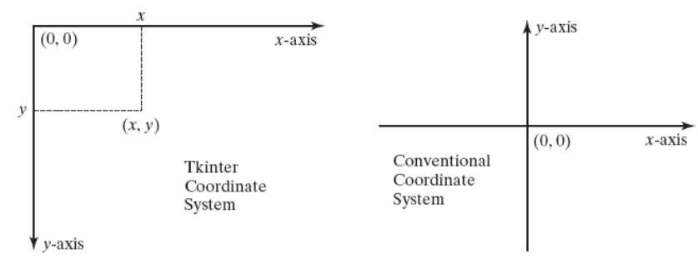
Coordinate system
The Tkinter coordinate system is measured in pixels, with (0,0) at its upperleft corner
Dasar-Dasar Pemrograman Ganjil 2016-2017

Slide 15
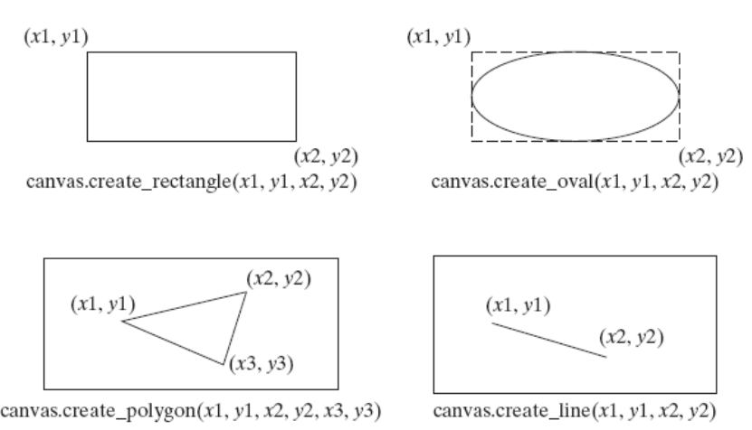
Coordinate system
Dasar-Dasar Pemrograman Ganjil 2016-2017

Slide 16
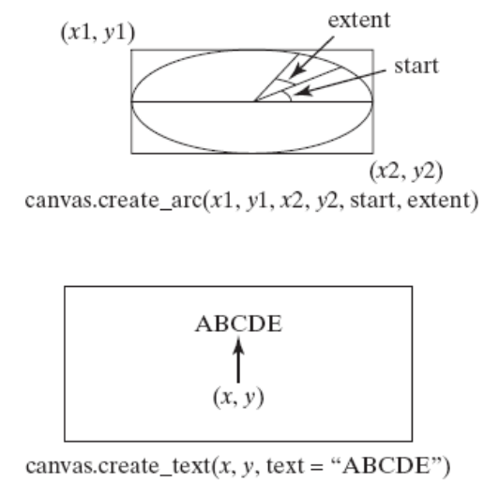
Coordinate system
Dasar-Dasar Pemrograman Ganjil 2016-2017

Slide 17
Canvas
All the drawing methods use the tags argument to identify the drawing. These tags are used in the delete method for clearing the drawing from the canvas
The width argument can be used to specify the pen size in pixels for drawing the shapes
The arrow argument can be used with create_line to draw a line with an arrowhead
The arrowhead can appear at the start, end, or both ends of the line with the argument value first, end, or both
The activefill argument makes the shape change color when you move the mouse cursor over it
Dasar-Dasar Pemrograman Ganjil 2016-2017

Slide 18
The Grid Manager
The grid manager places widgets into the cells of an invisible grid in a container
You can place a widget in a specified row and column
You can also use the rowspan and columnspan parameters to place a widget in multiple rows and columns
Study the following example
Dasar-Dasar Pemrograman Ganjil 2016-2017

Slide 19
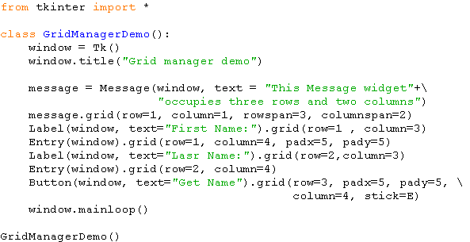
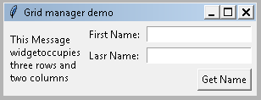
Example
Dasar-Dasar Pemrograman Ganjil 2016-2017

Slide 20
References
William Punch & Richard Enbody. The Practice of Computing using Python, 2nd Edition. Addison-Wesley, 2013
Y. Daniel Liang. Introduction to Programming Using Python. Prentice Hall, 2013.
John Zelle. Python Programming: An Introduction to Computer Science, 2nd Edition. Franklin, Beedle & Associates Inc., 2010.
Mark Lutz. Learning Python, 5th Edition. O’Reilly Media. Copyright 2013 Mark Lutz, 978-1-44-93-5573-9
L. Y. Stefanus. Slide Pelatihan Python. 2015.
Dasar-Dasar Pemrograman Ganjil 2016-2017

